Slide 1
Class 10
Client Side Programming
Failure is the key to success;
Each mistake teaches us something

Slide 2
DOM
What is DOM in JavaScript?
JavaScript can access all the elements in a webpage making use of Document Object Model (DOM). In fact, the web browser creates a DOM of the webpage when the page is loaded. The DOM model is created as a tree of objects like this:

Slide 3
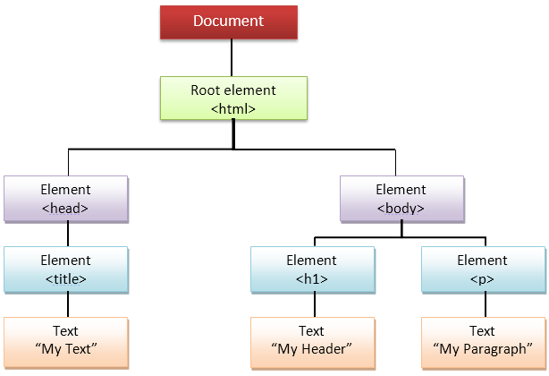

Slide 4
How to use DOM and Events
Using DOM, JavaScript can perform multiple tasks. It can create new elements and attributes, change the existing elements and attributes and even remove existing elements and attributes. JavaScript can also react to existing events and create new events in the page.
getElementById, innerHTML Example
getElementById: To access elements and attributes whose id is set.
innerHTML: To access the content of an element.

Slide 5
<html>
<head>
<title>DOM!!!</title>
</head>
<body>
<h1 id="one">Welcome</h1>
<p>This is the welcome message.</p>
<h2>Technology</h2>
<p>This is the technology section.</p>
<script type="text/javascript">
var text = document.getElementById("one").innerHTML;
alert("The first heading is " + text);
</script>
</body>
</html>

Slide 6
getElementsByTagName Example
getElementsByTagName: To access elements and attributes using tag name. This method will return an array of all the items with the same tag name.

Slide 7
<html>
<head>
<title>DOM!!!</title>
</head>
<body>
<h1>Welcome</h1>
<p>This is the welcome message.</p>
<h2>Technology</h2>
<p id="second">This is the technology section.</p>
<script type="text/javascript">
var paragraphs = document.getElementsByTagName("p");
alert("Content in the second paragraph is " + paragraphs[1].innerHTML);
document.getElementById("second").innerHTML = "The orginal message is changed.";
</script>
</body>
</html>

Slide 8
https://www.w3schools.com/js/js_htmldom_document.asp

Slide 9
<body bgcolor="silver" text="forestgreen" link="blue"
vlink="purple">
<font face="arial" size="+2">
<script type="text/javascript">
var tag_begin="<em>"; tag_end="</em><br />";
document.write("Location: "+ tag_begin +
document.location + tag_end);
document.write("Title: "+ tag_begin+
document.title + tag_end);
document.write("Back Ground: "+ tag_begin+
document.bgColor + tag_end);
document.write("Link color: "+ tag_begin+
document.linkColor + tag_end);
document.write("Text Color: "+ tag_begin+
document.fgColor + tag_end);
document.write("Last Modifier: "+ tag_begin +
document.lastModified + tag_end);
</script>
<a href=“thanks.html">Thanks!</a>
</font
</body>

Slide 10
FORM
HTML Forms are one of the main points of interaction between a user and a web site or application. They allow users to send data to the web site. Most of the time that data is sent to the web server, but the web page can also intercept it to use it on its own.
An HTML Form is made of one or more widgets. Those widgets can be text fields (single line or multiline), select boxes, buttons, checkboxes, or radio buttons. Most of the time those widgets are paired with a label that describes their purpose — properly implemented labels are able to clearly instruct both sighted and blind users on what to enter into a form input.
The main difference between a HTML form and a regular HTML document is that most of the time, the data collected by the form is sent to a web server. In that case, you need to set up a web server to receive and process the data. How to set up such a server is beyond the scope of this article, but if you want to know more, see Sending form data later in the module.

Slide 11
<html>
<head><title>An HTML Form</title></head>
<body>
<big>
<form name="form1" id="form1"
action="test10.php" method="GET">
<p><fieldset><legend>All About Me</legend></p>
Your Name:
<input type="text" name="name1_you" size="50" />
<p>
About You:<br />
<textarea name="comment" id="comment"
align="left" rows="5" cols="50">I was born on....
</textarea>
</p>
<p>Your Favorit food:
<strong>
<input type="radio" name="choice" id="choice1"
value="pecel"/>Pecel
<input type="radio" name="choice" id="choice2"
value=“pizza"/>Pizza
<input type="radio" name="choice" id="choice3"
value=“spagheti"/>Spagheti
<input type="radio" name="choice" id="choice4"
value=“hamburger"/>Hamburger
</p>

Slide 12
<p>Your City:<br />
<input type="checkbox" name="location" id="location1"
value="JKT"/>Jakarta<br />
<input type="checkbox" name="location" id="location2"
value="MDN"/>Medan<br />
<input type="checkbox" name="location" id="location3"
value="BDG" checked />Bandung
</p>
<p><b>Favorit Place:</b><br />
<select multiple name="place" id="place">
<option selected value="toba">Toba </option>
<option value="bali">Bali </option>
<option value="senggigi">Senggigi </option>
<option value="raja">Raja Ampat </option>
</select>
</p>
<p></fieldset></p>
<input type="submit" value="Submit"/>
<input type="reset" value="Clear"/>
</strong>
</form>
</big>
</body>
</html>

Slide 13
yourname18.php
<?php echo $_GET['location'] ?>

Slide 14
yourname18.html
Install XAMPP
Copy page 11,12 → yourname18.html
Modify page 13 so that it will show all of the data
Create Directory htdocs/yourname
Copy to directory htdocs/yourname
Start XAMPP
http://localhost/yourname/yourname18.html

Slide 15
Yourname19.html
Copy page 5 → yourname19a.html
Copy page 7 → yourname19b.html
Copy page 9 → yourname19c.html

